Slide 1
BCIG Annual UK Data Collection*
2025-26
Jenny Townsend
* All UK CI centres. Excludes Dublin Programme

Slide 2
New CI Referrals & Activity

Slide 3
Summary of UK CI referrals over time
100% of CI centres now accept referrals from private providers

Slide 4
CI referral rates per million 2025/26

Slide 5
Total new CI Activity*
01/04/25 - 31/03/26
 | Adults | Children
Unilateral | 1038 | 50
Bilateral Simultaneous | 21 | 384
Bilateral Sequential | 7 | 13
TOTAL Procedures: 1513 | 1066 | 447
TOTAL Implants: 1918 | 1087 | 831
*number of surgical procedures (not patients or ears), excludes revision/re-implantation surgeries

Slide 6
Implant procedures per million 2025-26

Slide 7
Total New CI Procedures / implants by centre
01/04/25 – 31/03/26
*sequential bilateral surgery counted as one implant

Slide 8
Total Re-implantation activity
01/04/2025 - 31/03/2026
Total: 153 re-implant procedures
167 implants replaced
‘in year’
167/32,842 =
~0.5% of caseload reimplanted

Slide 9
UK CI Implantation trend over time
(adult and paed)

Slide 10
UK Adult new implantations over time

Slide 11
UK Paeds new implantations over time

Slide 12
Referrals vs new implantations by centre
2025/26 – ordered by number of referrals
Mean conversion rate = 35%*
*implanting centres only, excluding centre R.
NB this is an in-year conversion rate (referrals received in year/ implants done in year) – this is a snapshot only and may be affected by e.g. changing waiting times.

Slide 13
CI Maintenance

Slide 14
Total number of maintained CI patients on 31/03/26 N = 24,899
Total number of
maintained implants
N = 32,842

Slide 15
Total number of UK maintained CI patients
By centre – 31/03/26

Slide 16
UK total CI patients maintained over last 10 years – adult vs paed

Slide 17
UK CI patients maintained over last 10 years - Unilateral vs bilateral

Slide 18
Total number of UK implanted ears maintained over time

Slide 19
Auditory Brainstem Implants

Slide 20
Total number of UK ABI recipients
01/04/24 – 31/03/2025
New Referrals
Adult: 2
Child: 10
No re-implantations were reported in 2025-26

Slide 21
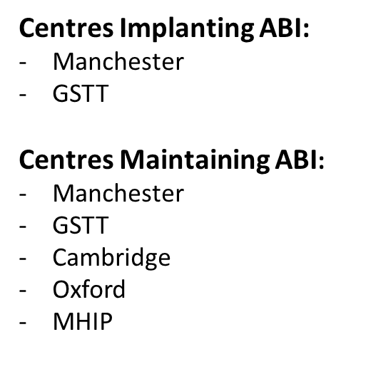
Total number of maintained ABI patients
31/03/26 N = 140
New Referrals:
- 2 adults
- 3 children

Slide 22
Narrative Summary 2026/27
Adult and Paed referral numbers have increased slightly again
Adult and Paed new activity is slightly down on 2024/25
CI re-implants ~0.5% of caseload
ABI numbers remain very low
Feedback from coordinators:
  Some element of increase in waits / capacity pressures
  Some element of increased ‘out of criteria’ referrals
  Some element of ‘blip’ last year with expected increase in referrals and activity in 2026/27

